Slide 1
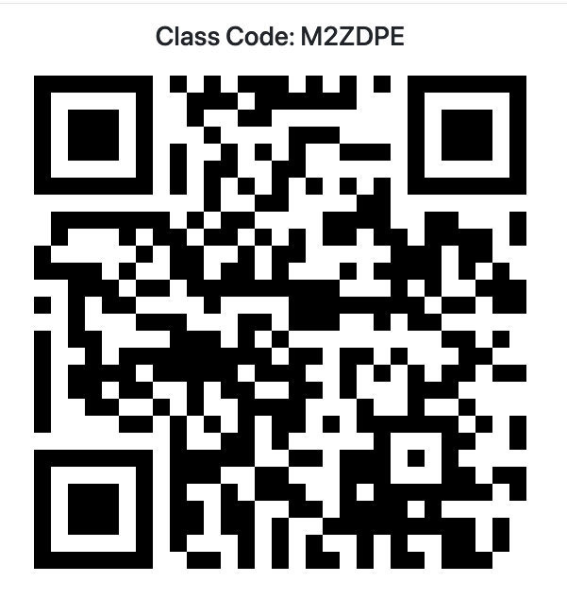
Attendance

Slide 2

Greedy Algorithms in Competitive Programming
Concepts, Use Cases, and Examples
Joshua Ganschow – DSU Computer Club
11/05/2024

Slide 3
What Are Greedy Algorithms?
Greedy algorithms are algorithms that build up a solution piece by piece, choosing the option that offers the most immediate benefit (locally optimal solution).
Make a locally optimal choice at each step, with the hope it leads to a globally optimal solution.

Slide 4
When to Use Greedy Algorithms
Problems that can be solved by making local decisions (without backtracking)
Problems where the optimal solution to a problem can be constructed from optimal solutions of its subproblems.
Examples:
Interval Scheduling
Coin Change
Dijkstra’s Shortest Path

Slide 5
Greedy Algorithm Framework
Identify the locally optimal choice
Ensure the choice is indeed locally optimal and safe to perform (won’t affect the global problem)
Ensure smaller problems can be generalized to be solved in the same way
Implement the solution (iterate over the subproblems and solve them)

Slide 6
Example Problem: Interval Scheduling
Given a list of intervals, find the maximum number of non-overlapping intervals.
Greedy choice: always pick the interval with the earliest ending time that doesn’t overlap with the previously selected one.
With the greedy choice, we have ensured that the subproblems won’t overlap each other.

Slide 7
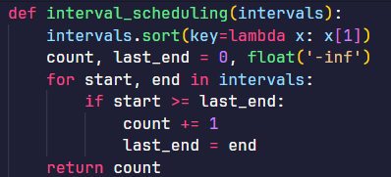
Interval Scheduling: Python code

Slide 8
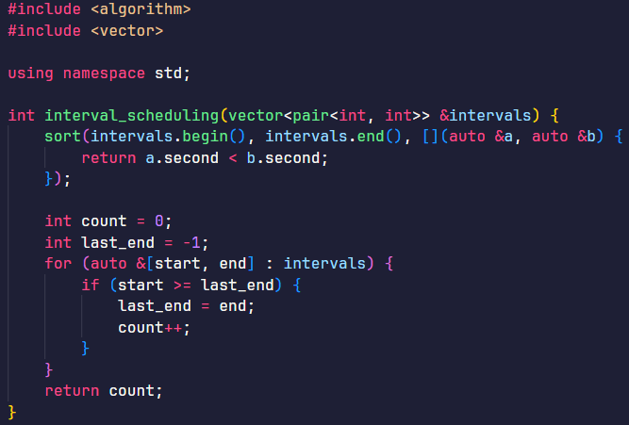
Interval Scheduling: C++ code

Slide 9
Example Problem on Kattis: Planting Trees
Problem Description: link

Slide 10
Example Problem on Kattis: Bank Queue
Problem Description: link

Slide 11
Caveat: Not Always Optimal
When optimal solutions depend on future choices
For some currency systems (with non-standard denominations), a greedy approach doesn’t guarantee the minimum number of coins. For instance, to make 15 cents using coins of 1, 6, 9, and 10. The greedy approach would be to first take the 10, then take the next available highest without going over. This gives the solution of 6 coins (10+1+1+1+1+1), but the optimal number is 2 (9+6).
When greedy choices don’t guarantee a global optimum
This is a little harder to define, but essentially you have to pay attention to the breakdown of the problem into subproblems and observe if solving those would truly give the optimal solution.

Slide 12
Caveat: Not Always Optimal
When problems require backtracking or recalculation
Greedy algorithms do not keep track of alternative solutions, so they do not work for these types of problems
When problems require an exact, not approximate, solution
Greedy algorithms often give approximate solutions, not exact ones.

Slide 13
Common Techniques for Problems Where Greedy Fails
Dynamic programming
It breaks down problems into subproblems (similar to greedy) but the optimal solution is built up, considering the whole picture rather than just the locally optimal solution.
Backtracking
When you encounter a point where there are no longer valid solutions, you can backtrack to the last point there were multiple and go with a different choice than you made last time. Useful for puzzle-like problems like Sudoku.
Branch and bound (not often used in competitive settings)
Solutions are explored with bounds to limit the search space.

Slide 14
Implementation Tips
Sorting is often a critical step (sort function in both Python and C++)
Heaps can be used for prioritizing, as well.
Practice different greedy algorithm problems to get a feel for how to split problems into subproblems.

Slide 15
Recap
Greedy algorithms find the locally optimal solution for subproblems in the hope that combining these together will create a globally optimal solution.
Works well for problems conducive to breaking down into subproblems where there is a guarantee of locally optimal to globally optimal connection. Doesn’t work well if this is not the case.
Advice for competitions: know the theory but also recognize when to pivot to a more advanced approach when greedy is not the way to go
Recommended reading: “The Greedy Guide: Essential Problems and Solutions for Competitive Programming” by Gary

Slide 16
Practice Problems
Easy: “Minimum Scalar Product” (minimumscalar) on Kattis
Medium: “Watering Grass” (grass) on Kattis
Hard: “Magic Checkerboard” (checkerboard) on Kattis

